Slide 1
Iteration Level Analysis
A module in
Agile Business Analysis
workshop
This work is licensed under the
Creative Commons Attribution-ShareAlike 4.0 International License.
To view a copy of this license, visit http://creativecommons.org/licenses/by-sa/4.0/.

Slide 2
Topics
Iteration review
Narratives
Showing progress
Managing change

Slide 3
BA Artifacts
Inception
Iterations
Vision
Prioritized business objectives
Roles & personas
Scenarios
Narratives
Story maps
Right sized stories
Initial story list (Backlog)
Release plan with estimate
Functional test matrix
Notes:
A number of artifacts are created during inception. Typically only 1 during Iterations.
To help get to an initial estimate, release plan
The analyst is key to understanding what needs to be built functionally
There are a number of techniques used to obtain that understanding.
Are all these documents kept up to date? Not unless you discover a large piece missing. A whole scenario missing from the process flow. A role missing or completely off the mark definition.
The level of detail of the inception artifacts are at a much higher level than traditional methodologies.

Slide 4
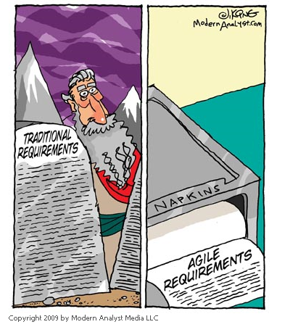
Notes:
1min

Slide 5
Iteration Review
Notes:
1min

Slide 6

Goals of an Iteration
To focus on developing the requirements that will provide working valuable software, which meets the business and project objectives.
Notes:
We are at the microscopic level of analysis during iterations.
We get to the lowest level of detail here.
Still trying to leave room for conversation.
Analyst responsibility - Prepare the artifacts necessary for development.
1min

Slide 7
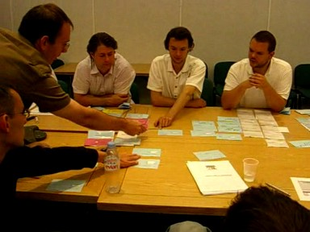
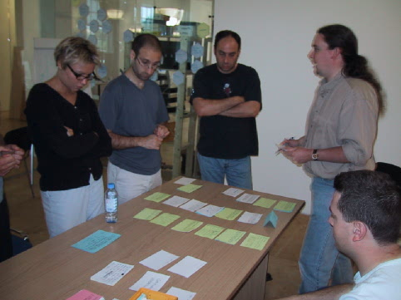
Iteration Planning
Done throughout
Using the backlog
Customer prioritizes
BAs clarify stories
Developers re-estimate
Stories selected
Other work considered
Committed to in a kick-off meeting
Plan adapted
Notes:
Most teams have moved from doing all the Iteration planning in one meeting to doing more of the planning throughout the previous iteration.
Analyst responsibility
Facilitate – conflict resolution, idea generation
Prepare narratives fully
Explain narrative functionality
Answer questions, clarify functionality
Help prioritize, select/defer stories
Low: 1min
High: 3min

Slide 8
The basics still apply
Analyze
Design
Code
Test
Deploy
Notes:
Remember the activities in each iteration.
The analyst is typically working an iteration ahead of development as far as ‘analysis’ work goes.
1min

Slide 9
Some timings differ
Analyze
Update design
Write unit tests/Code
Apply modified test matrix (test new and regress)
Deploy
Notes:
Remember the activities in each iteration.
The analyst is typically working an iteration ahead of development as far as ‘analysis’ work goes.
1min

Slide 10


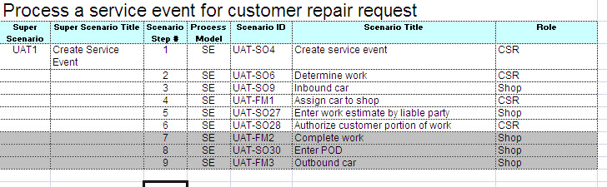
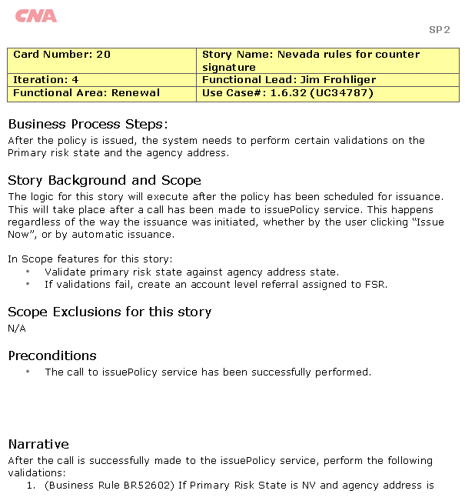
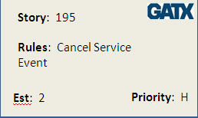
Analysis Artifacts
Multiple artifacts are created to support the development of a single story.
Roles and Personas
Process
Flows
Created during……..
Inception
Iterations
Notes:
Review the artifacts that were created during Inception.
Talk about the Narrative. Really the only artifact created during Iterations. JIT analysis.
Inception
Roles & Goals
Personas
Process Flows
Prototypes
[CLICK]
Scenarios
Stories
Iterations [CLICK]
Narratives
Low: 2min
High: 4min

Slide 11
A sample iteration schedule
Week 1 … Week 2
Stand-up
Stand-up
Stand-up
Stand-up
Stand-up
Stand-up
Stand-up
Iteration
Kickoff
Design
discussions
Analysis meetings
Development
Analysis
Analysis meetings
Design
discussions
Showcase
Prep
Development
Analysis
Development
Analysis
Development
Analysis
Development
Analysis
Development
Analysis
Showcase
Retrospective
Iteration
Planning
Wednesday
Thursday
Friday
…
Friday
Monday
Tuesday
What’s missing?
Notes:
Rookie error to start iteration on Monday. Too many holidays.
No standup on first morning of iteration
Glaring omission is ongoing testing
2 – 4 weeks is a normal length.
It’s a rookie error to start an iteration on Monday and finish it on a Friday. After all, it seems logical given the natural week boundaries. However, the number of public holidays that eat into Friday and Mondays can cause major headaches when it comes to re-scheduling showcase meetings and the like.
This schedule shows a common pattern of no standup on the first morning of a new iteration. As everyone’s context has switched since the end of the previous iteration, there’s normally very little continuity and makes stand-ups on these mornings of little value, especially once a team is up to speed.
The one glaring omission from this diagram is the ongoing testing effort required by the QA people. They will be doing spot inspections, regression testing and (possibly) automation for the majority of the iteration whilst development and analysis is going on.
Two to four weeks is a normal length for an iteration. It is a nice balance between setting a regular pace for the team and having enough time to deliver something demonstrable. If you feel the need to consider a longer iteration because the requirements are simply too big to get done properly within 2 weeks, then the size of the requirements is almost definitely the issue, not the size of the iteration.
Low: 2 min
High: 4 min

Slide 12
The life of a story across iterations
I0
I1
I2
I3
Planning
Planning
Planning
Elaboration
Elaboration
Elaboration
Build
Build
Build
I1 Activities
UAT Test
UAT Test
UAT Test
I2 Activities
Regression Test
Regression Test
I3 Activities
Notes:
For many people accustomed to single activity workflows, understanding the dynamics of an iterative project can be challenging. This diagram attempts to make a clear statement about the timing and nature of activities being conducted at any one time. The items of the same color are all activities required for a single development iteration, which requires planning and story elaboration (in the previous iteration), development and UAT (in the current iteration) and then regression testing (starting in the subsequent iteration.
And this set of tasks overlap for each iteration, so that at any point in time (looking down a vertical slice of the diagram), planning will be being done for the next development iteration, development and UAT will be in progress for the current development iteration and regression testing will be conducted for the previous development iteration.
Low: 1 min
High: 3 min

Slide 13
Iteration Zero Activities
Detailed just-in-time analysis for Iteration 1 stories
Write Iteration 1 narratives
Prep analyst environment
Story narrative lifecycle process defined
Define narrative template with customer
Review Iteration 1 story narratives with customer for sign off
Notes:
Story narrative lifecycle process hopefully has been done prior to iteration zero. This could have been done during initiation.
Narrative content varies from customer to customer – have yet to use the same narrative format twice. Help the customer define how heavy/light the narrative needs to be for their purposes
Prep analyst environment – get access to the existing application’s test environment and databases, in addition to dev environments.
Low: 2min
High: 3min

Slide 14
Narratives (Elaborated Stories)
Notes:
1min

Slide 15
Lifecycle of a Narrative
BA
Initial Requirements conversation
Prepare Draft Narrative
Design session
Update Narrative
Cust
Sign off Narrative
Dev
UX
Update Design
QA
Notes:
BA and customer discuss the requirements for the story. Start defining acceptance criteria.
BA prepares the first draft of the narrative
BA, Cust, Tech group and QA gather for a design session. Discuss implementation. Add acceptance criteria.
BA updates the narrative with design decisions and implementation details.
Customer may require final signoff before development begins.
Low: 2min
High: 4min

Slide 16
Why Narratives?
Expansion of the Story.
Lighter weight version of Use Cases
Just-in-Time
Greater detail
Detailed acceptance criteria
Notes:
They are an expansion of the Story.
Narratives can be compared to Use Cases, but lighter weight.
Scope of a Narrative is one story.
The scope of a Use Case is usually a scenario or group of stories.
Narratives are created ‘just in time’ , Iteration -1.
They go into details where the story card just cannot. They include detail necessary for successful implementation, testing and maintenance of the story.
Includes details, like screen mock up, data requirements, interface considerations, etc.
Includes detailed acceptance criteria.
Low: 2min
High: 5min

Slide 17
Narrative Elements
Scope
Story Element | Developer | Buisness | Tester
Scope | What needs to be built? | What user goal will this story fulfill? | When do I know that the story is completed?

Slide 18
Narrative Elements
UX
Story Element | Developer | Buisness | Tester
UX | What does it contain and what does it look like? | What user experience will this story deliver? | Does it conform to the guidelines?

Slide 19
Narrative Elements
Business Logic
Story Element | Developer | Buisness | Tester
Business logic | What behavior does it need to exhibit? | How does it work in actual life? | What different permutations should I test?

Slide 20
Narrative Elements
Business Rules
Story Element | Developer | Buisness | Tester
Business rules | What design considerations I need to have? | What validations does the system need to provide? | What are the different boundary values?

Slide 21
Narrative Elements
Scenarios
Story Element | Developer | Buisness | Tester
Scenarios | What different paths does the story cover? | What user actions should the system cope with? | What functional tests can I write?

Slide 22
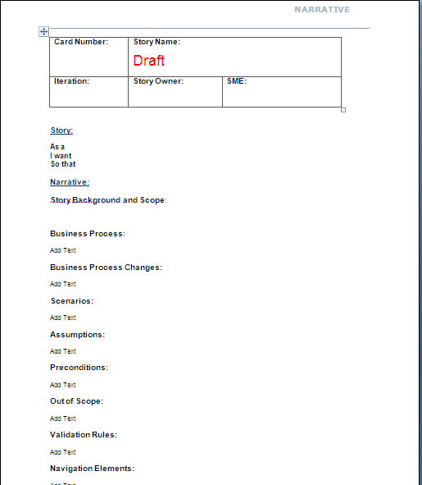
Narrative Template
Header
Purpose / Background / Context
Dependencies
Scope Exclusions
Business Rules
Screen Shots
RAID
Other
Acceptance Criteria
Notes:
Create a template to define the sections that are necessary for your project.
Header
Card #, Name, Iteration, Functional Area, Functional Lead, SMEs
Purpose /Background / Context
In a short paragraph or two the overview or summary section should introduce the reader what this narrative is about (story), why is this being done, and the business value it will generate.
Should tell the reader of where and how the functionality will fit in the overall picture and how it will change/enhance the existing system or add/expand the functionality of the proposed system.
Dependencies
It should also highlight the dependencies this feature has and what other features/functionality is related to this. The intention of dependencies and related features is to give the developer some clues upfront to prioritize their tasks and to direct them in the direction of existing functionality that is similar and may already be out there.
Scope Exclusions
This section should note any known scope areas that are not included in the story card.
Business Rules
Define any validations or exceptions handling that should occur
Screen Shots
Put screen shots here if editing or adding screens / fields
Risks, Assumptions, Issues, Dependencies
Used to set context of decisions made, approach taken or scope
Other details
Interface considerations
Security
Performance and other non functional considerations
Acceptance Criteria
End to end tests of the functionality. Should be how the customer would actually use the system in real life.
List the customer name(s) related to the story here. For questions / clarifications
Low: 5min
High: 10min

Slide 23

Writing acceptance criteria
Collaborative
Define “complete”
Use Wisdom of Crowds
Multiple criteria
All or nothing
Use a template?
Notes:
Derived with the customer and someone technical to provide feasibility
Ask the customer: What will you observe when the story is successfully complete?
Use Wisdom of Crowds
Most stories will generate multiple criteria
All must be met before the story can be completed
Consider using a template
Use the Wisdom of Crowds approach to defining.
Diverse set of independent individuals
Maximize the effectiveness of decision making process
BA, Biz, Devs, QA all participate in defining the acceptance criteria
Low: 2min
High: 5min
----------------------------------------------------------------------------------------------------------------------------------------
If you have attended the Leadership or Project Management training, you will recall the concept of Collective Wisdom, or Wisdom of the Crowds. In short, collective wisdom demands the use of a large, diverse set of independent individuals to maximize the effectiveness of decision making processes. This same approach should be considered for acceptance criteria in order to obtain the best coverage of criteria across the requirement. Developers, analysts, architects and testers should all be able to provide useful input to generating acceptance criteria.
If you don’t have any background information on these topics, try http://en.wikipedia.org/wiki/Collective_wisdom or http://en.wikipedia.org/wiki/The_Wisdom_of_Crowds .

Slide 24
SMART Acceptance Criteria
Specific
Explicitly defined and definite
Measurable
Possible to observe and quantify
Achievable
Capable of existing or taking place
Relevant
Having a connection with the story
Timely
When will the outcome be observed?
Notes:
SMART acronym is widely applicable to many situations
Used to rate suitability
5 criteria are interconnected.
Measurable will naturally be Achievable and Specific.
Timely – drives home the independent concept of a story.
Low: 1min
High: 3min
--------------------------------------------------------------------------------------------------------------
The SMART acronym is widely applicable to many situations and is also commonly used to rate meeting actions for suitability. The five criteria are somewhat interconnected in that Measurable criteria will probably also naturally be Achievable and Specific.
From a story point of view, the Timely criteria is worthy of separate discussion. It’s vital that the criteria for a story don’t assume the completion of another story in the same or later iterations. For obvious reasons you want to keep the criteria as independent as possible from other stories and not be linked to other stories that may or may not be delivered within the same timeframe.

Slide 25
Why?
Elaborate
Corroborate
Described by the business
Conditions
Conversation result
Business value abstractions
Not tests
Boundary conditions
Notes:
Elaborate stories
Corroborate stories
Are described by the business
Are a set of conditions that the story must meet for it to be accepted as complete
Do not replace the conversation. They are one of the results of the conversation
Are abstractions of what business value will be observed
Are not tests - tests are concrete examples of acceptance criteria
Provide the boundary conditions for stories

Slide 26
Iteration Level
GIVEN
(State of the system/ Role performing the action)
WHEN
(Action that is going to be performed)
THEN
(What is expected to happen)
Notes:
Low: 1min
High: 3min

Slide 27
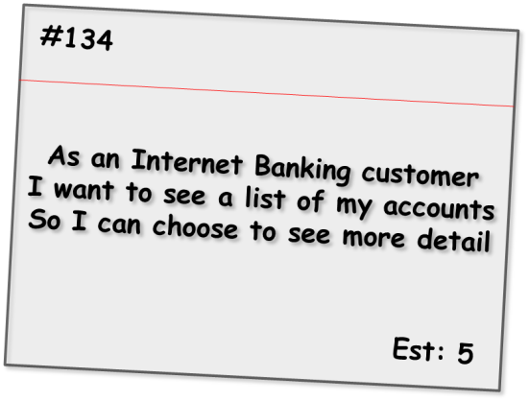
Acceptance criteria samples
Given the customer has one transaction account and one credit account
When they have completed logging in
Then the screen should show the names and numbers of the two accounts sorted in account number order
Given the customer has just one transaction account
When they have completed logging in
Then the screen should show the name and number of the account
Alternate path
Given the customer has no accounts
When they have completed logging in
Then the screen should show a message stating that no accounts are available
Alternate path
Given the customer has more than 20 accounts
When they have completed logging in
Then the screen should show the first 20 accounts (in account number order) only
Bad path
Given the customer has some accounts
When they have completed logging in
And the system cannot retrieve the account details
Then the screen should show an error message with associated code and details to contact for support
Notes:
This format is iteration level acceptance criteria vs Inception level.
Shows positive, alternate and bad paths.
Talk through each one.
Low: 3min
High: 6min
-----------------------------------------------------------------------
Here we see a set of criteria for an Internet Banking story covering a range of positive, alternate and bad paths through the requirement. As is expected, the positive paths map directly to the requirements as stated and assume everything is working as expected.
The alternate path criteria describe non-standard ways to meet the desired outcome, which although may not be considered within the narrative of the story, are still reasonable to assume as usage patterns for the system.
Bad path criteria describe situations in which the outcome cannot be achieved, in this case how the system would behave in the case of an internal error.

Slide 28
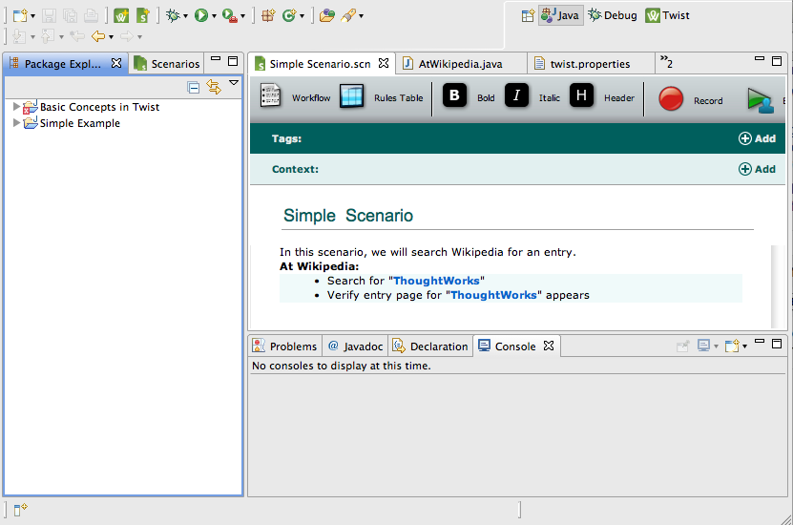
Automated Functional Tests

Slide 29
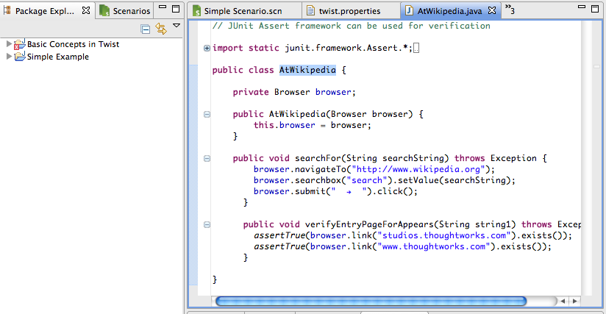
Link Requirements to Code

Slide 30
What Makes Stories Different?
What is the difference between how you represent requirements today and representing requirements via a story?
Notes:
Lengthy documentation, writing lengthy requirements specifications all up-front
In traditional development projects, these stories often aren't captured as they are told, they're captured through a longer analysis process and passed on in a document to the developers; a format that isn't particularly user friendly.
Stories are written from a user perspective, requirements in traditional analysis are more technical and often solution orientated.
Stories are written on cards and therefore more visual, not in a lengthy requirement doc which only a few might read.
Low: 2min
High: 4min

Slide 31
What makes stories different?
How do you think representing requirements via stories will be valuable to you during analysis?
Notes:
Gain a shared understanding and provide a means of collaboration between the development team and the customer or users
Deliver business value fast through working pieces of software
Allow fast feedback
Flexibility to change because easy to move around or rip up if required,
Keeping User Stories small enough to fit on a card helps to ensure that requirements are broken into small, manageable pieces of functionality, i.e. individual features.
Cards also work nicely in conjunction with whiteboards, providing clear visibility of progress and enabling team collaboration, moving cards around the board as things progress.
Low: 2min
High: 5min

Slide 32
Create a Narrative Template
Break into groups
Review the Narrative Template provided
Design the Narrative template to be used by your organization
Present your proposed template discussing each section you included and/or deleted
Notes:
Pick a recent challenge you’ve experienced.
Low: 10min
High: 20min

Slide 33

Debrief
What went well?
What key learnings did you take from that exercise?
What still puzzles you?
Notes:
Debrief:
What went well?
What key learning's did you take from that exercise?
What still puzzles you?
Low: 5min
High: 15min

Slide 34
Showing Progress
Notes:
1min

Slide 35
When is a story done?
Developer Complete
Customer Acceptance
Testing Verification
Done!






Notes:
In short, a story can be considered done when its:
Coded
Meeting coding standards
Included in the automated tests
Passed through the build
Verified by the BA
Verified in a trusted environment by the customer… with advice from the tester(s)
The whole team should work on reducing this cycle time
It is vital that neither the PM nor IM bows to pressure (either internal or external) to skimp on any of these steps (usually the latter 2) in order to “fake” completion of stories. Although they may get away with it in the short term, it increases the risk of poor quality software being considered “done” and will result in significant delays when these processes are commenced again later in the project. Enforced overtime to complete stories or extending iteration length to include “almost finished” stories is another example of gaming the system to provide a false sense of heightened velocity. The best thing project management can do is get an accurate picture of the team’s velocity under sustainable working conditions and use that for forward planning.
Low: 3min
High: 6min

Slide 36
Visibility
Story wall
Progress by feature
Burnup charts
Finger charts
Notes:
The BA will assist the IM in tracking ‘doneness’ by providing status daily on stories that being worked on.
1min

Slide 37
Story Wall
Ready
Planned
In Progress
In Testing
Done
A
B
D
E
F
C
G
H
Notes:
Shows the progress of stories through the iteration
Columns defined by the team
Shows areas of concern
2min

Slide 38
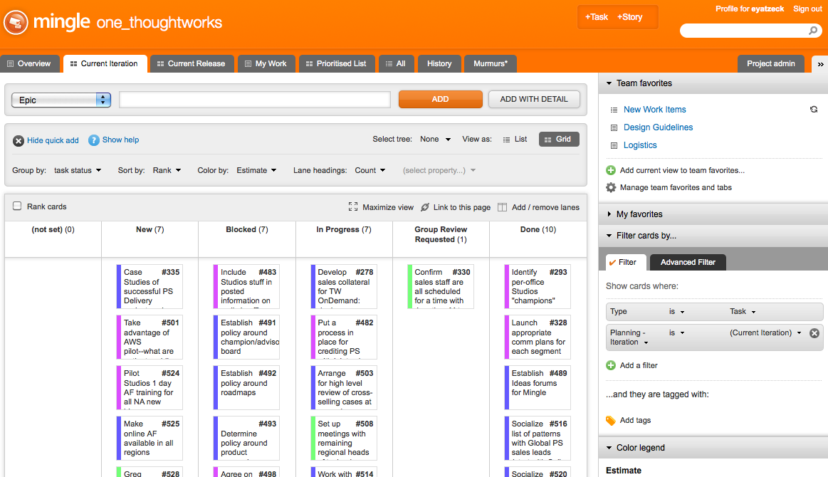
Electronic Story Wall

Slide 39
Progress by feature or theme

Slide 40
Iteration Burn up
30
25
20
Scope
15
Progress
10
5
0
W
Th
F
M
T
W
Th
F
M
T
Notes:
We committed to 23 story points in this iteration.
About Thur, the IM noticed that we were moving faster than expected and called on the analyst and the customer to provide an additional story to pull in.
On a daily basis, everyone can see how the team is doing.
The team should define what ‘done’ means on this particular chart.

Slide 41
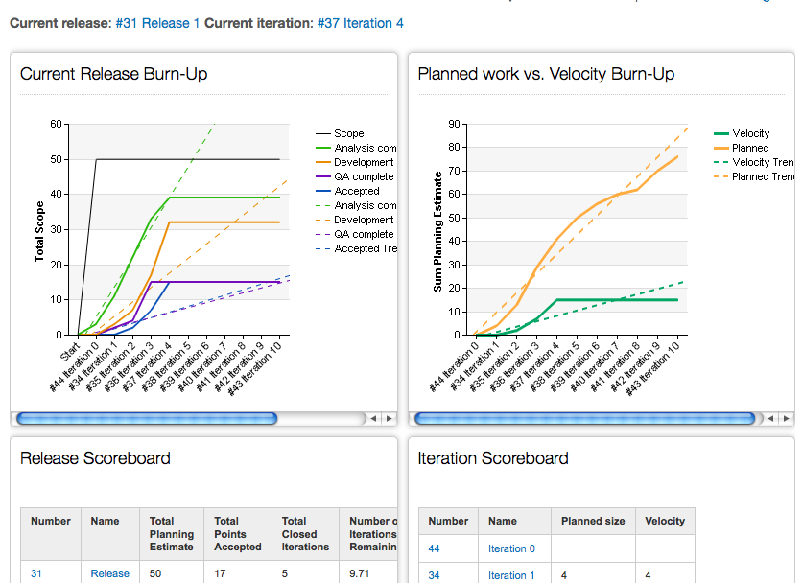
Electronic Reporting

Slide 42
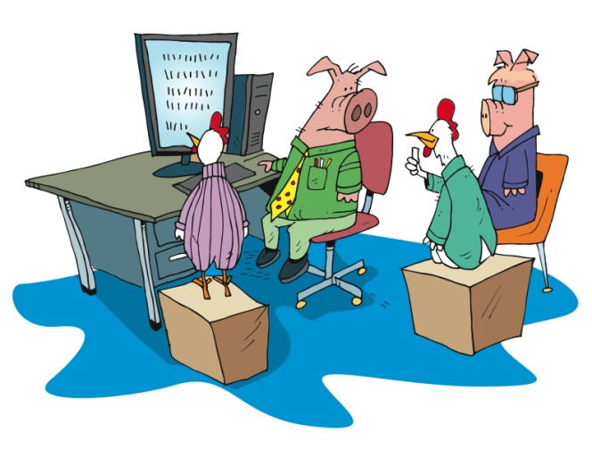
Agile project lifecycle
Working software showcased to the business
Develop & deploy
(12+ weeks)
Notes:
How do we show progress?
Talk about UAT – psychologically, people want to “kick the tires”
2min

Slide 43
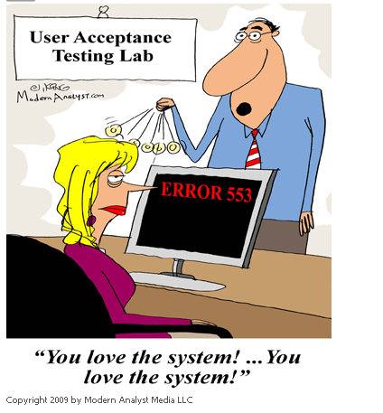
Notes:
1min

Slide 44
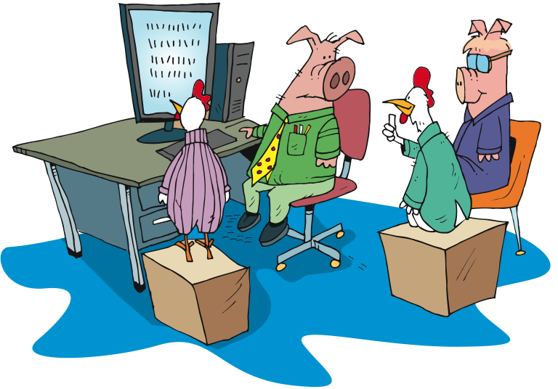
Showcases
Notes:
Goal - Working software at the end of each iteration
Showcase at the end of each iteration
Not design session or brainstorming
For the chickens who aren’t a part of the day to day
We do get feedback
Feedback may turn into new stories
BA works with PM/IM, Biz to determine priority of the new stories
Who runs these? Usually the BA. Ideally the customer.
Low: 2min
High: 5min
-------------------------------------------------------------------------------------------------
With the goal of ensuring that information and knowledge are spread throughout team and stakeholders, and that the team gets valuable feedback as early as possible, we follow each Iteration with a showcase.
During the showcase, we show what has been done during the Iteration just completed. This is not a design session, nor a brainstorming session. The purpose of the showcase is to say “here’s what we’ve gotten done” and to solicit input from the participants. It is not unusual for additional stories to be generated as a result of the showcase, as stakeholders gain a greater understanding of what is actually being delivered and the value that goes with that.
This is not to say that we don’t share what we’re doing prior to the showcase. It’s that the showcase is the time when we say “this is what we’ve gotten done” and actively seek feedback from stakeholders who are not normally involved on a daily basis – the Chickens.

Slide 45
Managing Change
What questions will you ask the client to determine how to handle the change?
Notes:
What are the client’s motivations for the change?
Is there a reason they want to deviate from corporate direction? Has there been a change in branding or is a future change expected?
What is the priority of this change? Can it be done in a future release or a different project?
Is there something else that can be done to achieve the same result?
Are they happy to have other cards moved and reprioritized to ensure this change is made?
Low: 2min
High: 5min

Slide 46
Managing Change
What actions will you need to take to ensure the change is made effectively?
Notes:
Take a guess on the cost and time for change to occur and ask client if they are happy for you to continue with the analysis of the change.
Notify IM/PM of the change.
Research cost of change, time that will be required, value to business and any rippling effects
Talk to developers and project team to come with new options or requirements.
Provide options to client when analysis is completed.
Low: 2min
High: 5min

Slide 47
Managing Change
What options could you provide the client?
Notes:
Advise impact of change – and have client agree on new story card.
Finalise new story card and ensure client and team have it estimated and prioritized
Advise against change if this is more of a personal preference and not a corporate directive and therefore value to business is minimal.
Advise any other possibilities the team has come up with during talks.
Low: 2min
High: 5min

Slide 48
Review
Iteration review
Narratives
Showing progress
Managing change

Slide 49
BA Artifacts
Inception
Iterations
Vision
Prioritized business objectives
Roles & personas
Scenarios
Narratives
Story maps
Right sized stories
Initial story list (Backlog)
Release plan with estimate
Functional test matrix
Notes:
A number of artifacts are created during inception. Typically only 1 during Iterations.
To help get to an initial estimate, release plan
The analyst is key to understanding what needs to be built functionally
There are a number of techniques used to obtain that understanding.
Are all these documents kept up to date? Not unless you discover a large piece missing. A whole scenario missing from the process flow. A role missing or completely off the mark definition.
The level of detail of the inception artifacts are at a much higher level than traditional methodologies.

Slide 50
Questions?

